Slide 1
M2M & LTE-M(5G)
Stig Griebenow - Thang Truong – David Lacoste - Rémi Goalard

Slide 2
M2M concept
LTE-M protocol
Security & Energy
Use case example
Recap & conclusion

Slide 3
M2M concept

Slide 4








M2M concept
Machine 2 machine : autonomous communication
M2M or IoT
M2M standardization
Security
Industrial
Robotics
M2M fields
Logistic / fleet managment
Remote monitoring
Traffic control

Slide 5




M2M concept
M2M or IoT
IoT
M2M
IoT
M2M

Slide 6
M2M concept
Machine 2 machine : autonomous communication
M2M or IoT
M2M standardization
Security
Industrial
Robotics
M2M fields
Logistic / fleet managment
Remote monitoring
Traffic control

Slide 7
M2M concept
M2M standardization
Fiware
OneM2M
OneM2M specifications :
- Power consumption
- Scalability
- Security
- Interoperability
- Latency …
BUTLER
Open-IoT
AllJoyn

Slide 8




M2M concept
Which protocol?
WiFi
ZigBee
LTE-M
LoRa

Slide 9
LTE-M

Slide 10
LTE-M protocol
NAS (Non-Access Stratum)
IP (Internet Protocol)
Layer 3
RRC (Radio Resource Control )
RRC PDU's
User Traffic
(Control Traffic)
PDCP (Packet Data Convergence Control)
PDCD Control
RLC Control
PDCP PDU's
Radio Bearers
Layer 2
RLC (Radio Link Control)
MAC Control
RLC PDU's
Logical channels
MAC (Media Access Control)
L1 Configuration & Measurement
MAC PDU's
Transports channels
Layer 1
Physical Layer (DL:- OFDM, UL-US-OFDM)
Source : tutorialspoint.com - LTE Protocol Stack Layers

Slide 11
LTE-M protocol
Layer | Functions
Physical | CRC attachment - Coding block - Scrambling/descrambling - Modulation/de-modulation - Measurement - Resource element mapping/demapping - HARQ - MIMO
Mac | Channel mapping – Multiplexing - Handling control elements - Random access procedure - Logical channel priority – HARQ - Sending BSRs
RLC | Buffer status report - Segmentation and concatenation - ARQ (for AM mode) - Re-ordering - Assembly - ARQ (for AM mode)
PDCP | Sequence number addition - Handover data handling - Integrity protection – Ciphering - Header compression - In sequence delivery - Duplicate packet detection - Integrity validation - Deciphering - Header decompression

Slide 12
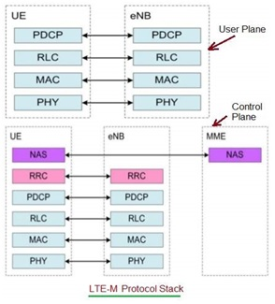
LTE-M protocol
RRC :
- Configuration Management
- Connection Management
- Paging control
- Security Management
- Broadcast
- Measurement configuration
- Measurement Reporting
- Cell selection and reselection
- Mobility Management
Source : www.rfwireless-world.com

Slide 13
Capabilities of LTE-M
LTE-M
LC-LTE/MTCe
eMTC
LTE Cat 0
LTE Cat M1
LTE Cat M2
non-BL
3GPP Release
Release 12
Release 13
Release 14
Release 14
Downlink Peak Rate
1Mbit/s
1Mbit/s
4Mbit/s
4Mbit/s
Uplink Peak Rate
1Mbit/s
1Mbit/s
7Mbit/s
7Mbit/s
Latency
Not deployed
10ms
Number of Antennas
1
1
1
1
Duplex Mode
Full or half duplex
Full or half duplex
Full or half duplex
Full or half duplex
Device receive bandwidth
1.4-20 MHz
1.4 MHz
5 MHz
5 MHz
Receiver Chains
1 (SISO)
1 (SISO)
1 (SISO)
1 (SISO)
Device Transmit Power
23 dBm
20/23 dBm
20/23 dBm
20/23 dBm

Slide 14
LTE-M: Physical Layer

Slide 15
LTE-M physical layers
Downlink physical layer | Uplink physical layer
Modulation : OFDM | Modulation : SC-FDMA
Subcarrier spacing : 15 kHz | Subcarrier spacing : 15 kHz
Modulation types : QPSK – 16QAM - 64QAM | Modulation types : QPSK – 16QAM - 64QAM
Antenna techniques : Transmit diversity & spatial multiplexing | Antenna techniques : Transmit diversity & spatial multiplexing
Physical channels & signals : PBCH – PDCCH – PDSCH – PCFICH – PHICH -RSs | Physical channels & signals : PUCCH - PUSCH – PRACH – DMRS - SRSs
Device receive bandwidth : 1 MHz or 5 MHz | Device receive bandwidth : 1 MHz or 5 MHz
Downlink peak rate : 1 Mbit/s | Uplink peak rate : 1 Mbit/s or 7 Mbit/s
Duplex mode : half or full | Duplex mode : half or full
Antenna number required : 1 (SISO) | Antenna number required : 1 (SISO)
Device transmit power : 20 dBm or 23 dBm | Device transmit power : 20 dBm or 23 dBm

Slide 16








LTE-M features
Device receive bandwidth
Modulation scheme and HARQ processes
Device transmit power
Voice over network
Duplex mode, half-duplex mode
Extended coverage
Antenna configuration
Peak rate

Slide 17
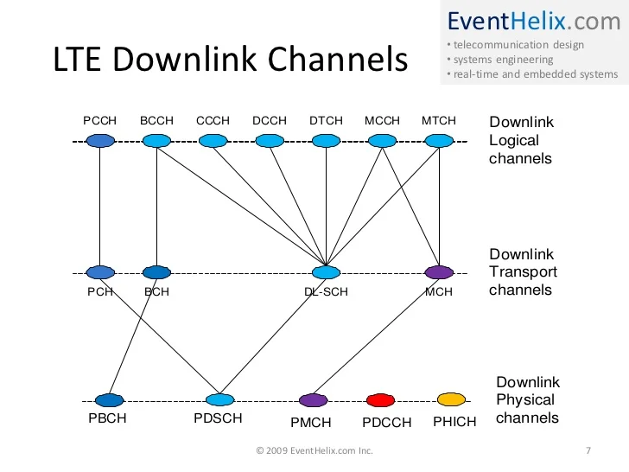
LTE-M channels mapping
Source : www.EventHelix.com

Slide 18
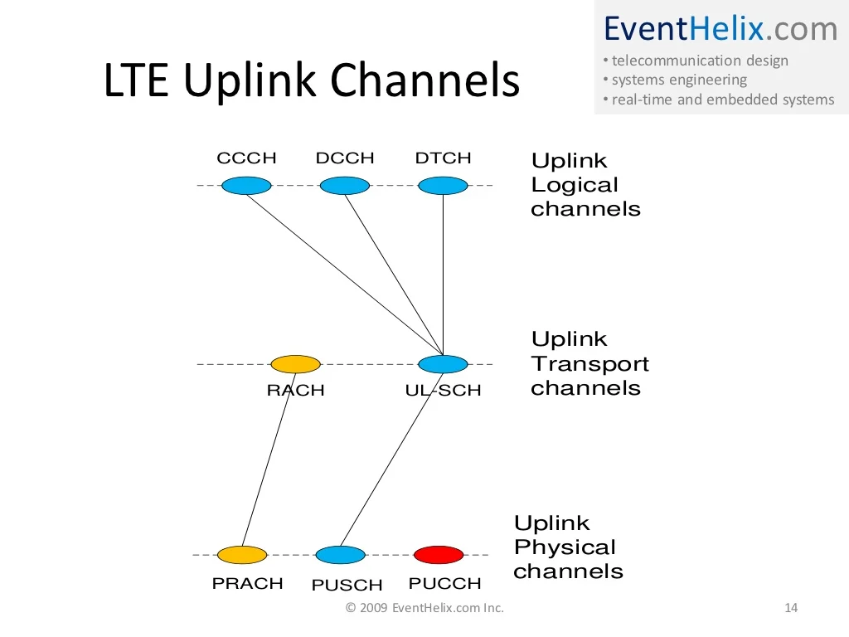
LTE-M channels mapping
Source : EventHelix.com

Slide 19
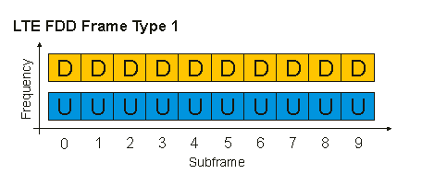
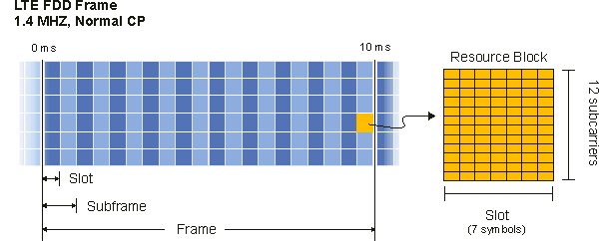
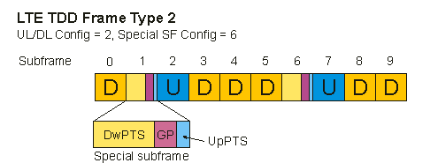
LTE-M frames
Bandwidth | Resource Blocks | Subcarriers (downlink) | Subcarriers (uplink)
1.4 MHz | 6 | 73 | 72
3 MHz | 15 | 181 | 180
5 MHz | 25 | 301 | 300
10 MHz | 50 | 601 | 600
15 MHz | 75 | 901 | 900
20 MHz | 100 | 1201 | 1200
Source : https://rfmw.em.keysight.com/wireless/helpfiles/89600B/WebHelp/subsystems/lte/content/lte_overview.htm

Slide 20
LTE-M: MAC Layer

Slide 21
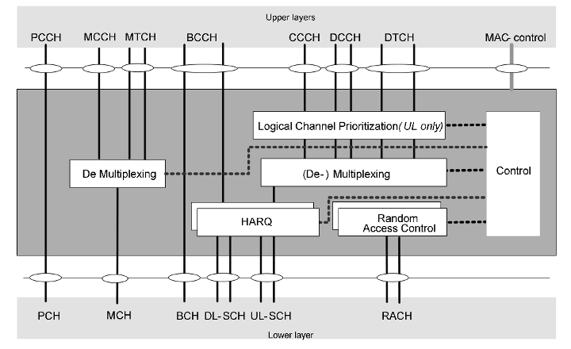
The MAC-Layer maps between the logical and the transport channels
Logical
channels
Transport channels
Source : http://www.3glteinfo.com/lte-mac-layer-medium-access-control/

Slide 22
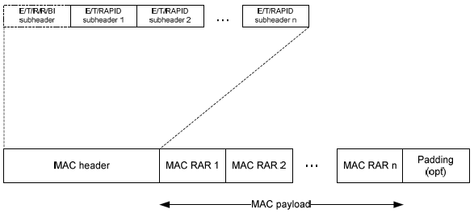
The MAC-Layer PDU
Source : https://www.sharetechnote.com/html/MAC_LTE.html (Accessed 29.11.23)

Slide 23
LTE-M: Energy and Security

Slide 24
LTE-M Energy per Bit
Avg. E/B
100B
0.96 [mJ]
1000B
0.11 [mJ]
Ratio
0.11065
Table 4.2 : Energy per Byte and ratio between 1000B & 100B transmitted, LTE-M
Source : Ekman, T., & Jönson, S. (2020). An empirical study of cellular-IoT

Slide 25
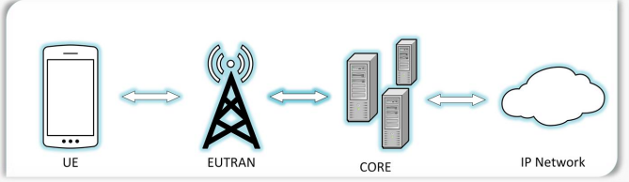
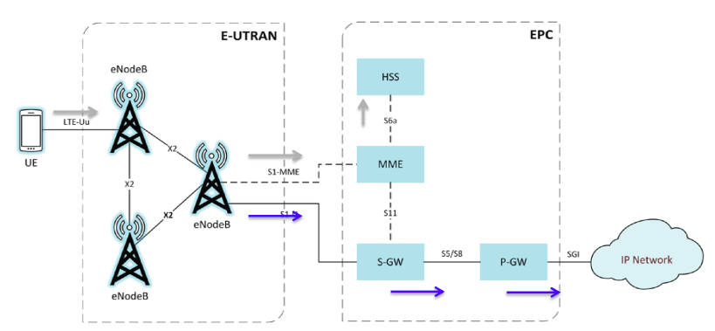
Security
- SIM cards & tokens
- Authentication (from device & network)
- Air interface protection
- Radio to core network protection
LTE defenses & behavior :
Sources :
- NIST Special Publication 800-187 Guide to LTE Security
- D. Forsberg, G.Horn, W.-D. Moeller, and V. Niemi, LTE Security, 2nd ed., John Wiley & Sons, Ltd.: United Kingdom, 2012
- 3GPP TS 33.401 V17.34.0 (20222023-0906)

Slide 26
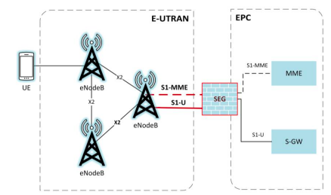
Security
SIM cards & tokens :
- UICC Token
- Hardware storage location for sensitive information pre-shared key and IMSI
- Performs cryptographic operations for authentication
- Limited access to the UICC via a restricted API
Air interface protection:
- The connection between the UE and the eNodeB is referred to as the air interface
- Each crypto algorithm provided confidentiality protection, integrity protection
Authentication:
- Authentication and Key Agreement (AKA) is the protocol used for devices to authenticate with the carrier to gain network access
- The cryptographic keys needed to encrypt calls are generated upon completion of the AKA protocol
Radio to core network protection :
- Backhaul Protection radio network to core network
- IPSEC tunnel created between eNodeB & SEG
- Multiple benefits provided by IPSEC.

Slide 27
LTE-M in practice

Slide 28
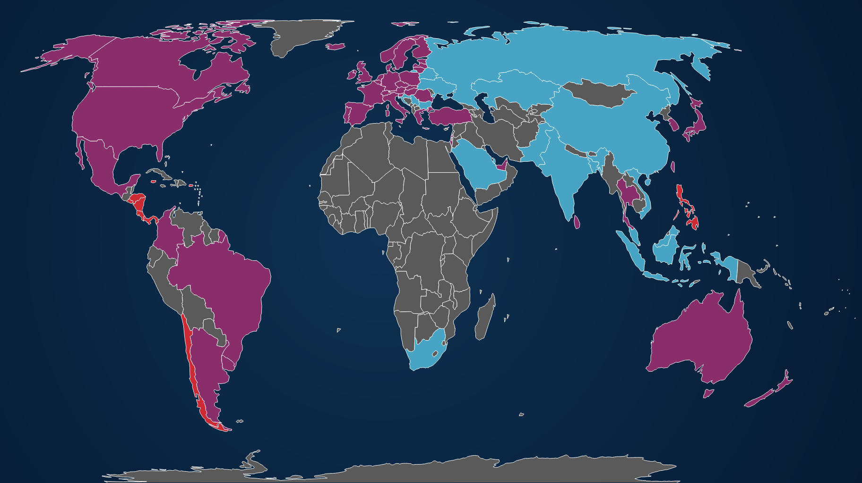
LTE-M worldwide coverage
Source : https://www.gsma.com/iot/deployment-map/ (Accessed 29.11.2023)

Slide 29
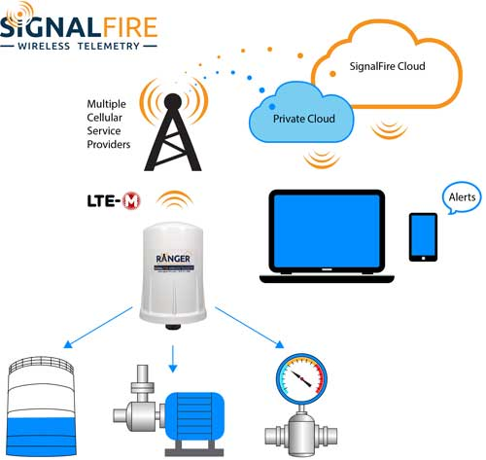
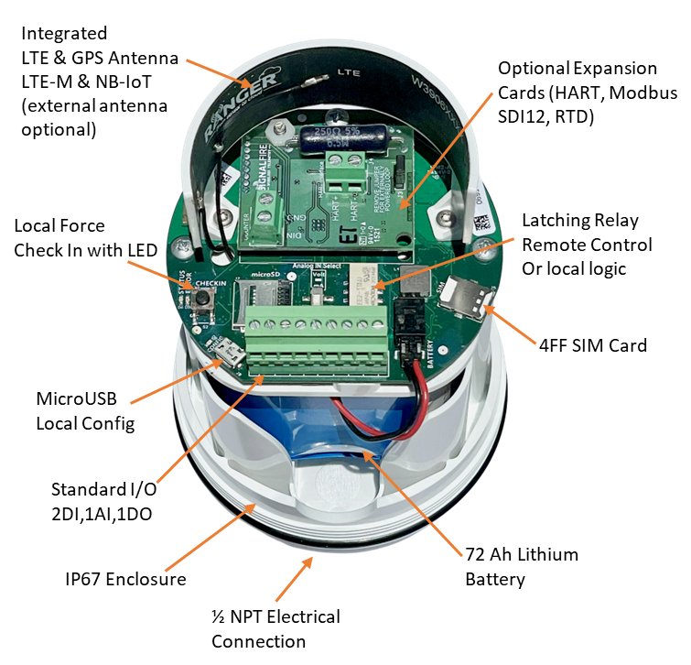
Use case 1 example – IIOT industrial device monitoring
Motor, Tank, Pressure and flow sensor

Slide 30
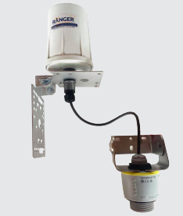
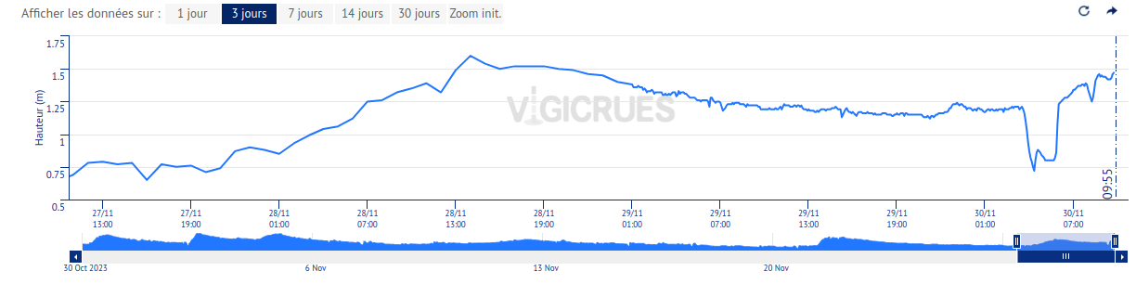
Use case 1 example – IIOT industrial device monitoring
Real example monitoring river level (similar hardware)

Slide 31
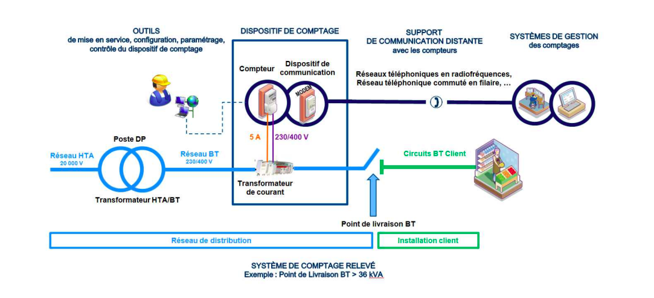
Use case 2 example – Electricity metering utility : Enedis France
Mobile Com before 2G/3G in progress LTE-M 632k modems to upgrade
PLC Communication (Power Line Communications)

Slide 32
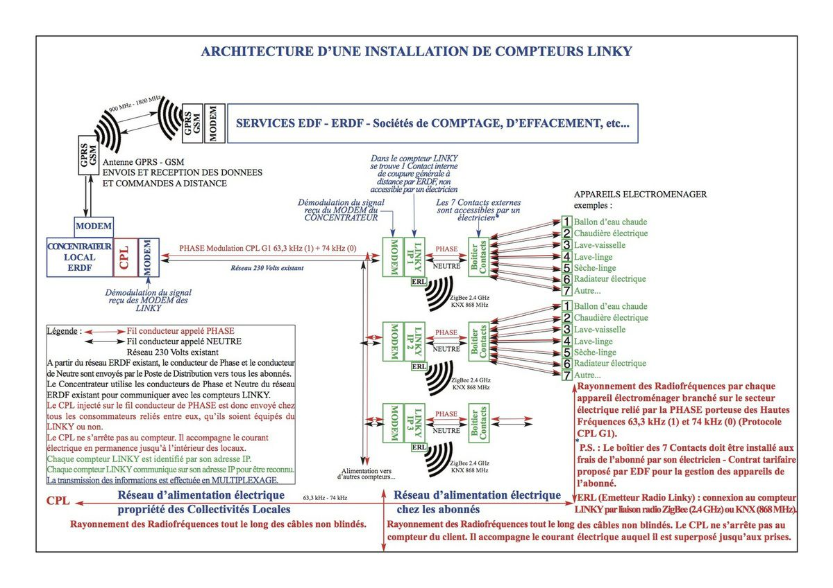
Use case 2 example – Electricity metering utility : Enedis France
Modem/GW Upgrade

Slide 33
Conclusion

Slide 34
Conclusion
Machine 2 machine => autonomous communication + consortia standards
Number of nodes per network | 50.000
Range | From 5 to 100km
Data rate | 1-7Mbit/s (depend on mode) => quite high
Energy per byte | 0.96-0.11 mJ/byte
Latency | 10 ms
Power consumption | Best at medium data rates
Indoor penetration | Good
Bandwidth | 1.4 Mhz or 5 Mhz
Device cost | Medium to high

Slide 35
Feature | LTE-M | LoRaWAN | Bluetooth | Sigfox | NB-IoT
Bandwidth | 1.4 MHz or 5 MHz | 125 kHz, 250 kHz, or 500 kHz | 1 MHz or 2 MHz | 100 Hz | 200 kHz
Data rate | Up to 1 Mbit/s (uplink and downlink) | Up to 50 kbit/s (uplink and downlink) | Up to 2 Mbit/s (Bluetooth 5.0) | Up to 100 bit/s (uplink) and 600 bit/s (downlink) | Up to 250 kbit/s (uplink and downlink)
Latency | About 10 ms | About 1 s | About 3 ms (Bluetooth 5.0) | About 50 s | About 1.6 s
Mobility | Full duplex or half duplex mode, handover support | Half duplex mode, no handover support | Full duplex mode, handover support | Half duplex mode, no handover support | Half duplex mode, no handover support
Voice support | VoLTE or CSFB | VoIP (third-party) | Yes | VoIP (third-party) | No
Deployment | Existing LTE networks | Dedicated gateways and base stations | Peer-to-peer or mesh network | Dedicated gateways and base stations | Existing 2G or 4G networks
Spectrum | Licensed | Unlicensed | Unlicensed | Unlicensed | Licensed
Device transmit power | 20 dBm or 23 dBm | Up to 14 dBm | Up to 10 dBm (Bluetooth 5.0) | Up to 16 dBm | 20 dBm or 23 dBm
Device battery life | Up to 10 years | Up to 10 years | Up to 5 years | Up to 10 years | Up to 10 years
Device cost | Medium to high | Low to medium | Low | Low | Medium to high

Slide 36
Backup

Slide 37
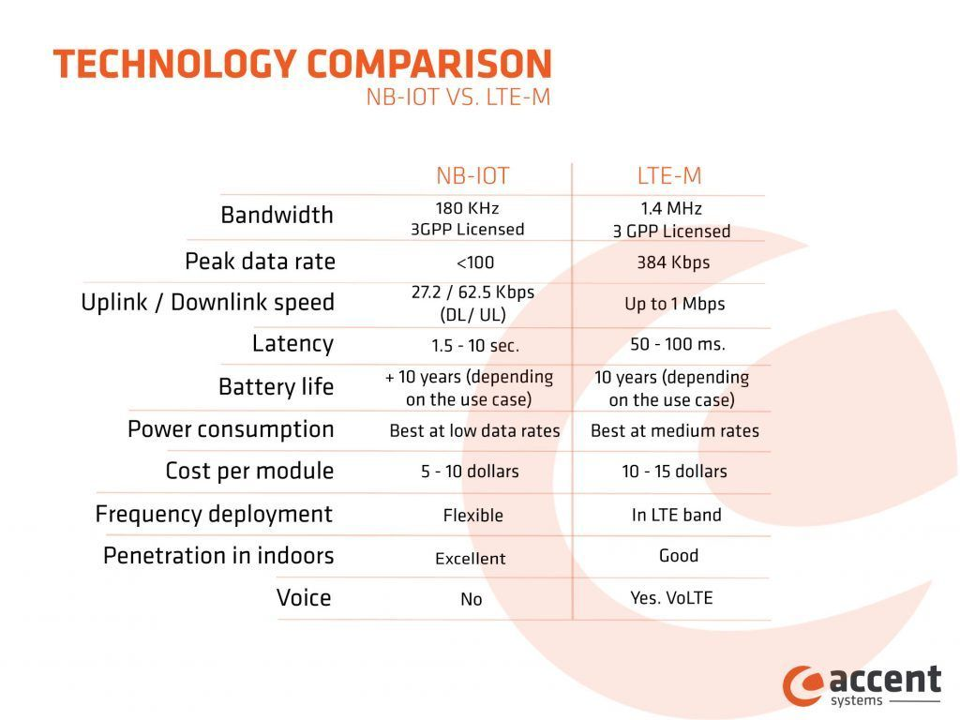
LTE-M vs. NB-IoT

Slide 38
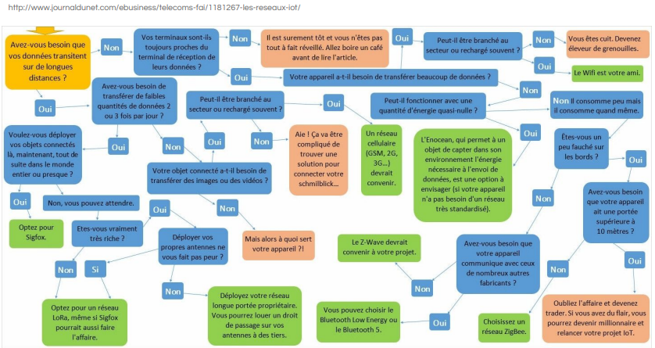
Choose your protocol

